Slide 1
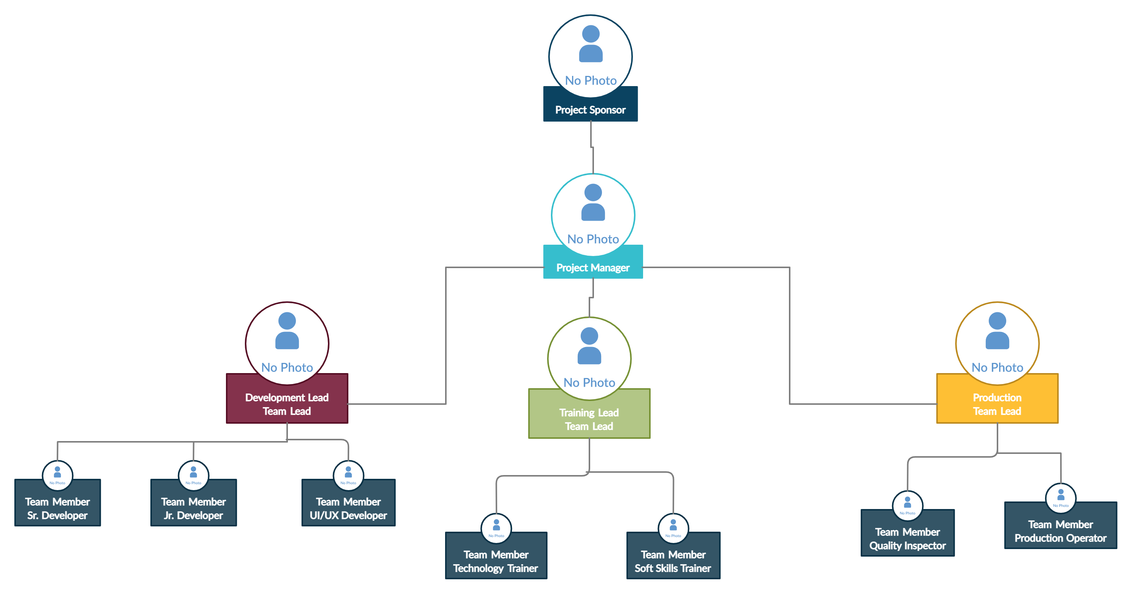
Location tracking shoe for kids
Organizational Chart
05/28/2021

